Slide 1

Olympic Performance Analytics Dashboard
Domo

Slide 2
Project Description:
This Olympic Performance Analytics Dashboard provides an interactive visualization of athlete participation, medal distribution, and country-wise performance trends. Built using Domo, the dashboard allows users to analyze key Olympic statistics across multiple dimensions such as sports, gender, host cities, and medal trends over the years.

Slide 3
Key Features:
Athlete Participation Analysis:
Displays the Top 10 most popular sports by athlete participation.
Analyzes athlete age distribution across male and female competitors.
Medal Distribution Insights:
Yearly breakdown of Olympic medals (Gold, Silver, Bronze).
Tracks Olympic medal distribution trends over time with historical comparisons.
Highlights total medal counts by hosting city for different Olympic events.
Country-Wise Performance:
Identifies the top 10 countries with the highest gold medals.
Provides insights into medal trends by country, sport, and gender.
Interactive Filters & Selections:
Allows users to filter by year, gender, medal type, sport, season, and country.
Enables deep-diving into specific data points for comparative analysis.

Slide 4
Use Cases:
Track historical Olympic performance by country and sport.
Identify trends in medal distribution across different Olympic games.
Analyze gender participation and age demographics of athletes.
Evaluate which sports have the highest athlete engagement.
Support data-driven decision-making for sports federations and analysts.
This dashboard is a valuable tool for Olympic analysts, sports researchers, and enthusiasts, offering a data-driven perspective on Olympic performance trends.

Slide 5

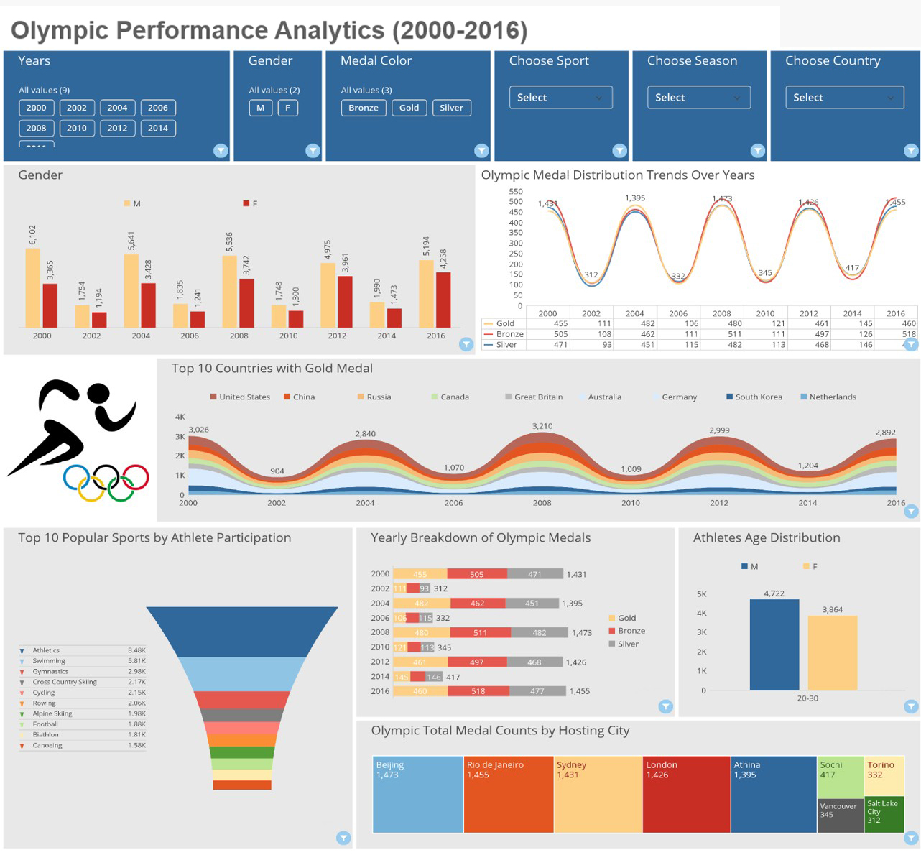

Slide 6
Thank you
Marwah Al-Badran
469-536-2644
Skyeye_88@hotmail.com
Portfolio:

